Slide 1

Department of CSE-AI & ML (CSM)
Team:09
Regd No:20BQ1A4220 (TL), 20BQ1A4201,
20BQ1A4262, 20BQ1A4246
Project Title: AISkinXpert
Al-based tool for preliminary diagnosis of Dermatological Manifestations
Team Members:
  Gopavarapu Hari Chandana - 20BQ1A4220
  Addanki Sandhya Grace - 20BQ1A4201
  Vemula Chenchu Naga Lakshmi - 20BQ1A4262
  Rekapalli John Blessing - 20BQ1A4246
Under Guidance of : Byra Pardha Saradhi
(Project Guide) HOD-CSM,
Mr. Byra Pardha Saradhi Dr. K. Suresh Babu

Slide 2
Department of CSE-AI & ML (CSM)
Team:09
Regd No:20BQ1A4220 (TL), 20BQ1A4201,
20BQ1A4262, 20BQ1A4246
Literature Survey:
This literature review delves into recent advancements in skin disease detection, emphasizing the transformative potential of web-based applications powered by deep learning algorithms like AISkinXpert. Studies showcasing the effectiveness of convolutional neural networks for accurate classification underscore the feasibility of automated skin disease analysis, laying a strong foundation for such applications. While web interfaces offer advantages over mobile apps in terms of computing resources and user experience, challenges persist, including the need for diverse and unbiased datasets, robust security measures, and clear user education to mitigate concerns regarding data privacy and potential misdiagnosis. Despite these challenges, the outlined strategies for AISkinXpert development, informed by the evolving landscape of skin disease detection research, promise a responsible, accurate, and user-centric approach to improving diagnosis and patient outcomes.Problem Statements We Have Reviewed:
    Problem Statement1 /Description Domain1 ML / AI /DL /NLP (Methodology1)
    Problem Statement2/Description Domain2 ML / AI /DL /NLP (Methodology1)
    Problem Statement3 /Description Domain3 ML / AI /DL /NLP (Methodology1)
    Problem Statement4/Description Domain4 ML / AI /DL /NLP (Methodology1)
Selected Problem Statement: Al-based tool for preliminary diagnosis of Dermatological Manifestations
Selected Problem Statement Domain: MedTech / BioTech / HealthTech
Problem Statement Selection Source / Platform: Smart India Hackathon 2023
Problem Statement Registered Organization: Ministry of Ayush
Problem Statement Outcome / Output/Purpose: Developing an AI Dermatologist for accurate preliminary diagnoses to revolutionize dermatological care and enhance healthcare quality.

Slide 3
Department of CSE-AI & ML (CSM)
Team:09
Regd No:20BQ1A4220 (TL), 20BQ1A4201,
20BQ1A4262, 21BQ1A4246
Problem Statement Title: Al-based tool for preliminary diagnosis of Dermatological Manifestations.
Problem Description:
The Global Burden of Disease project has shown that skin diseases continue to be the 4th leading cause of nonfatal disease burden worldwide. These conditions are often the presenting face of more severe systemic illnesses, including HIV and neglected tropical diseases (NTD). such as elephantiasis and other lymphedema-causing diseases. Additionally, skin disorders pose a significant threat to patients' well-being, mental health, ability to function, and social participation. However, it is very difficult to provide better dermatological care to under-served or resource-poor regions in a cost-effective manner owing to the unavailability of efficient diagnostic tools, lack of connectivity, poor laboratory infrastructure, etc. Moreover, there is also a scarcity of physicians with dermatological training. Even, preliminary screening of a dermatological manifestation seems to be an arduous task. Thus, developing an Artificial intelligence-based tool (through an Image processing technique) for preliminary diagnosis of numerous dermatological conditions will prove to be a boon in the health care system.
Problem-Related Existing Solution / System:
The existing system in dermatological diagnostics, integrating Convolutional Neural Network (CNN) algorithms, represents a significant advancement in leveraging deep learning for skin disease analysis. CNNs, specialized in processing visual data, are trained on extensive dermatological image datasets to recognize patterns indicative of various skin conditions. This process involves multiple layers of feature extraction, leading to objective and consistent diagnoses compared to traditional methods reliant on individual expertise. While CNNs facilitate quicker and more accurate diagnoses, they are not intended to replace clinical judgment but rather complement it. However, challenges such as data dependency, lack of explainability, overfitting risks, resource intensity, and the need for AI-assisted diagnostics to be used in tandem with human expertise must be addressed to ensure optimal performance and user trust in these systems.

Slide 4
Department of CSE-AI & ML (CSM)
Team:09
Regd No:20BQ1A4220 (TL), 20BQ1A4201,
20BQ1A4262, 21BQ1A4246
Problem Statement Title: Al-based tool for preliminary diagnosis of Dermatological manifestations.
Proposing System (PS)/solution for the Problem Statement Description Modules:
1. User Registration and Login:
1. Users should be able to create accounts with unique usernames and passwords.
2. This allows for personalized access to the system and maintains user data security.
2. User Profile Management:
1. Users should have the ability to manage their profiles, including updating personal information and preferences.
2. This feature ensures that user data is accurate and up-to-date.
3. Image Upload and Preprocessing:
1. Users can upload dermatological images from their devices.
2. Uploaded images undergo automatic preprocessing to enhance quality and remove noise

Slide 5
Department of CSE-AI & ML (CSM)
Team:09
Regd No:20BQ1A4220 (TL), 20BQ1A4201,
20BQ1A4262, 21BQ1A4246
PROJECT REVIEW - 0
4. Skin Detection:
1. The system employs AI algorithms to detect and analyze skin conditions from uploaded images.
2. Provides preliminary diagnoses with associated confidence scores.
5. Diagnostic Reports:
1. After analysis, the system generates detailed diagnostic reports.
2. These reports include lists of potential skin conditions, descriptions, and potential causes.
6. Risk Detection & Remedies:
1. The system identifies risk factors associated with diagnosed conditions.
2. Offers recommendations or remedies to mitigate these risks.
7. Doctor Appointment:
1. Users can schedule appointments with healthcare professionals.
2. Facilitates both in-person and remote consultations, improving access to healthcare.

Slide 6
Department of CSE-AI & ML (CSM)
Team:09
Regd No:20BQ1A4220 (TL), 20BQ1A4201,
20BQ1A4262, 21BQ1A4246
PROJECT REVIEW - 0
8. Multiple Languages:
1. Supports multiple languages to cater to a diverse user base.
2. Enhances accessibility for users from various linguistic backgrounds.
9. Feedback Mechanism :
1. Implements a feedback system where users can confirm the accuracy of the preliminary diagnosis.
2. The feedback loop aids in continuously improving the AI model.

Slide 7
Department of CSE-AI & ML (CSM)
Team:09
Regd No:20BQ1A4220 (TL), 20BQ1A4201,
20BQ1A4262, 21BQ1A4246
PROJECT REVIEW - 0
Problem Statement Title: Al-based tool for preliminary diagnosis of Dermatological manifestations.
Functional Requirements of Problem Statements:
1. User Registration and Login
2. User Profile Management
3. Image Upload and Preprocessing
4. Skin Detection
5. Diagnostic Reports
6. Risk Detection & Remedies
7. Doctor Appointment
8. Multiple Languages
9. Feedback Mechanism

Slide 8
Department of CSE-AI & ML (CSM)
Team:09
Regd No:20BQ1A4220 (TL), 20BQ1A4201,
20BQ1A4262, 21BQ1A4246
PROJECT REVIEW - 0
Problem Statement Title: Al-based tool for preliminary diagnosis of Dermatological manifestations.
Non-Functional Requirements of Problem Statements:
  1. Security
  2. Performance
  3. Scalability
  4. Reliability
  5. Usability
  6. Data Privacy
  7. Data Integrity
  8. Accessibility

Slide 9
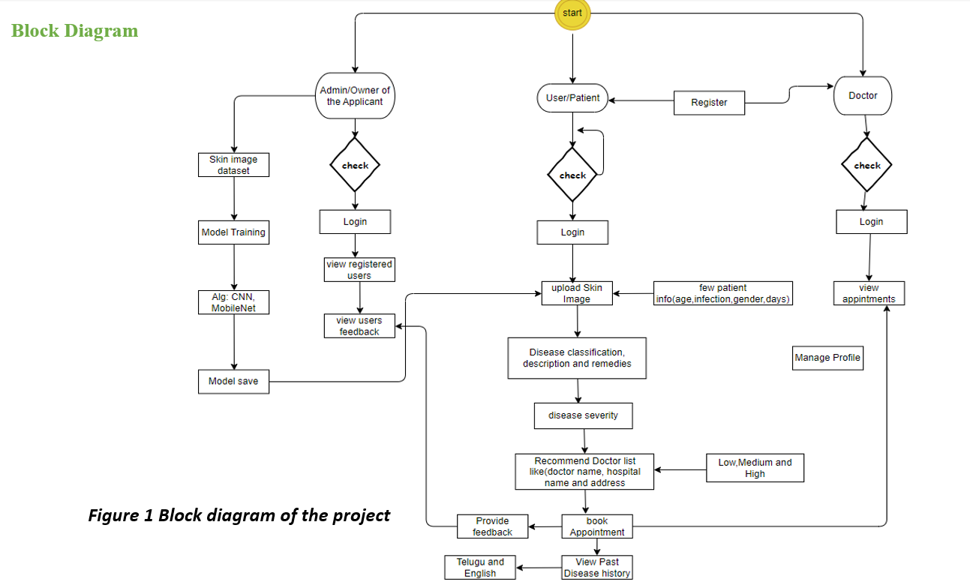
Department of CSE-AI & ML (CSM)
Team:09
Regd No:20BQ1A4220 (TL), 20BQ1A4201,
20BQ1A4262, 21BQ1A4246
Problem Statement Title: Al-based tool for preliminary diagnosis of Dermatological manifestations.
System Architecture

Slide 10
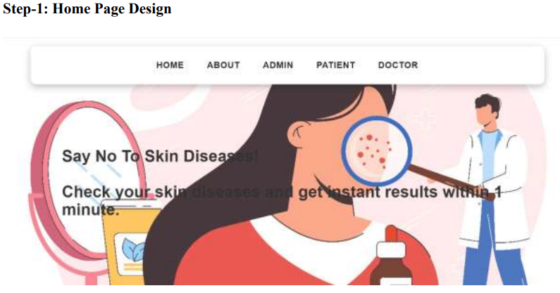
Department of CSE-AI & ML (CSM)
Team:09
Regd No:20BQ1A4220 (TL), 20BQ1A4201,
20BQ1A4262, 21BQ1A4246
Problem Statement Title: Al-based tool for preliminary diagnosis of Dermatological manifestations.
Results:

Slide 11
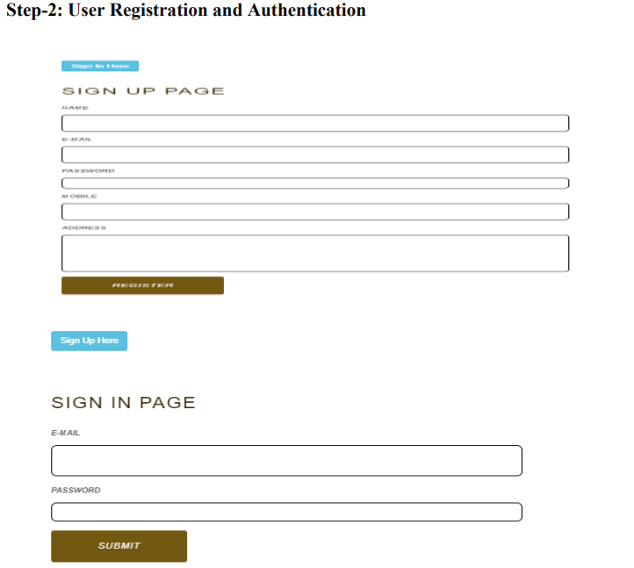
Department of CSE-AI & ML (CSM)
Team:09
Regd No:20BQ1A4220 (TL), 20BQ1A4201,
20BQ1A4262, 21BQ1A4246
PROJECT REVIEW - 0

Slide 12
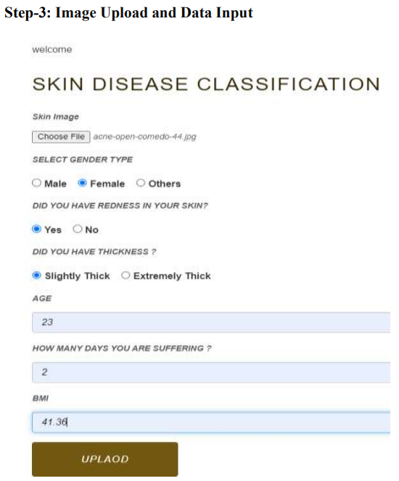
Department of CSE-AI & ML (CSM)
Team:09
Regd No:20BQ1A4220 (TL), 20BQ1A4201,
20BQ1A4262, 21BQ1A4246
PROJECT REVIEW - 0

Slide 13
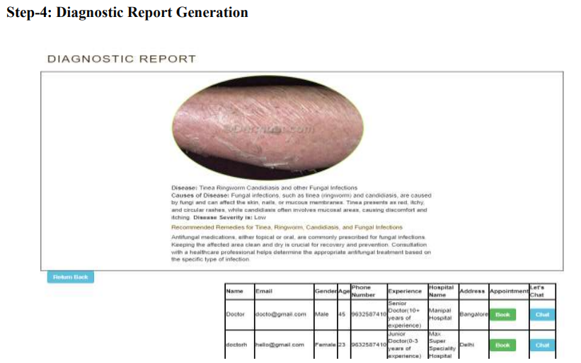
Department of CSE-AI & ML (CSM)
Team:09
Regd No:20BQ1A4220 (TL), 20BQ1A4201,
20BQ1A4262, 21BQ1A4246
PROJECT REVIEW - 0

Slide 14
Department of CSE-AI & ML (CSM)
Team:09
Regd No:20BQ1A4220 (TL), 20BQ1A4201,
20BQ1A4262, 21BQ1A4246
Problem Statement Title: Al-based tool for preliminary diagnosis of Dermatological manifestations.
Software Tools Required for the Proposed System:
Front-end Tools: 1. IDE (Integrated Development Environment): Visual Studio
2. Front-End Development: HTML, CSS, JavaScript
Back-end Tools: 3. Back-End Development: Python, Flask
    4. Database Management: MYSQL
Deployment Tools: Pythonware
Technologies: Python, HTML, CSS, Javascript, MYSQL
Monitoring Tools: monstering the model performances
Special Tools like Clouds, Micro services, APIs, Mobile APIs.

Slide 15
Department of CSE-AI & ML (CSM)
Team:09
Regd No:20BQ1A4220 (TL), 20BQ1A4201,
20BQ1A4262, 21BQ1A4246
Problem Statement Title: Al-based tool for preliminary diagnosis of Dermatological manifestations.
Team members Allocated Features and Sub tasks
Team member 1: Feature 1,3,5
Team member 2: Feature 2,4
Team member 3: Feature 6,7
Team member 4: Feature 8,9

Slide 16
Department of CSE-AI & ML (CSM)
Team:09
Regd No:20BQ1A4220 (TL), 20BQ1A4201,
20BQ1A4262, 21BQ1A4246
PROJECT REVIEW - 0
Problem Statement Title:
Al-based tool for preliminary diagnosis of Dermatological manifestations.
Conclusion:
The conclusion of the project on the ResNet50 model for dermatological image classification acknowledges its progressive learning but highlights challenges like moderate accuracy and overfitting. It showcases the potential of convolutional neural networks for diagnosing skin conditions, yet emphasizes the need for a more diverse training dataset. The project underscores the importance of comprehensive data and advanced training methodologies for AI-driven diagnostics. Future research should aim to refine the model to capture diverse manifestations of skin conditions, ensuring high accuracy and reliability in clinical settings.
Thank you

